Slide 1
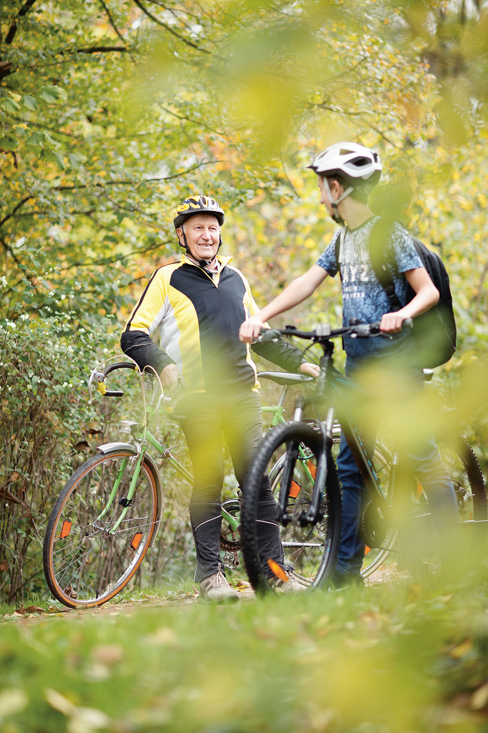
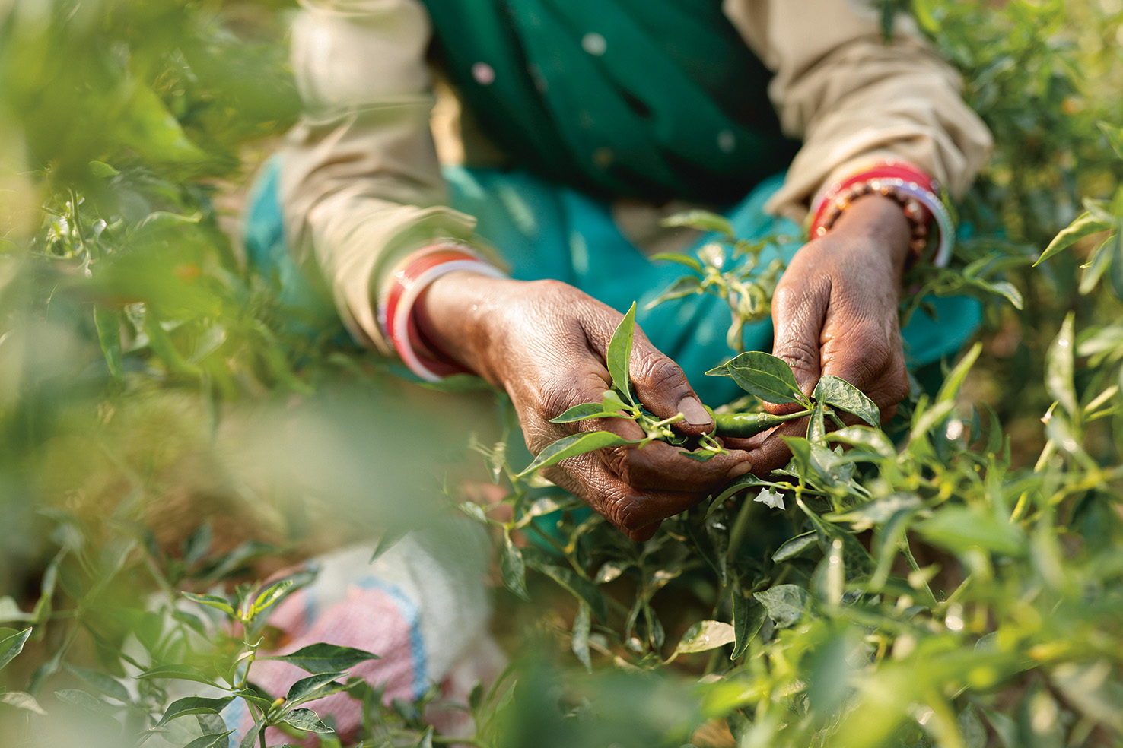
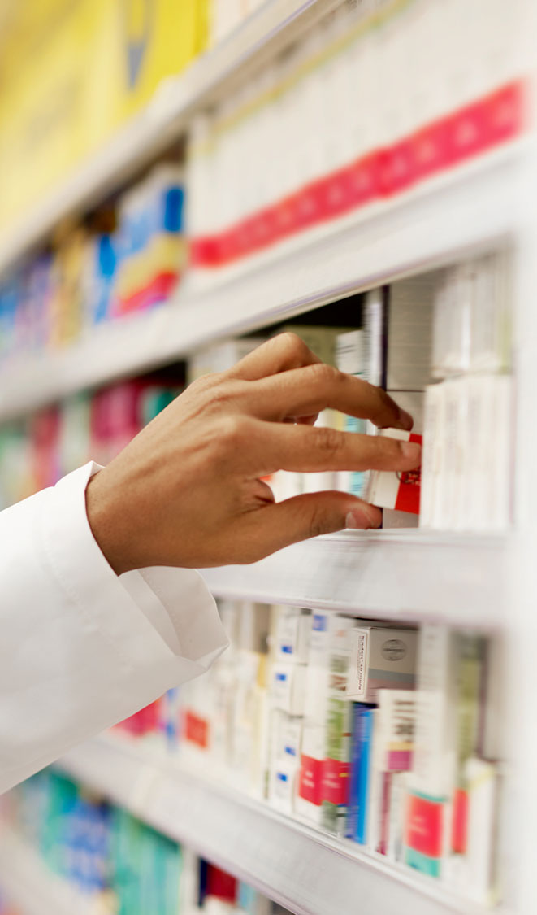
Benchside to Bioinformatics: A Bayer Perspective
Kyle Stiers

Slide 2
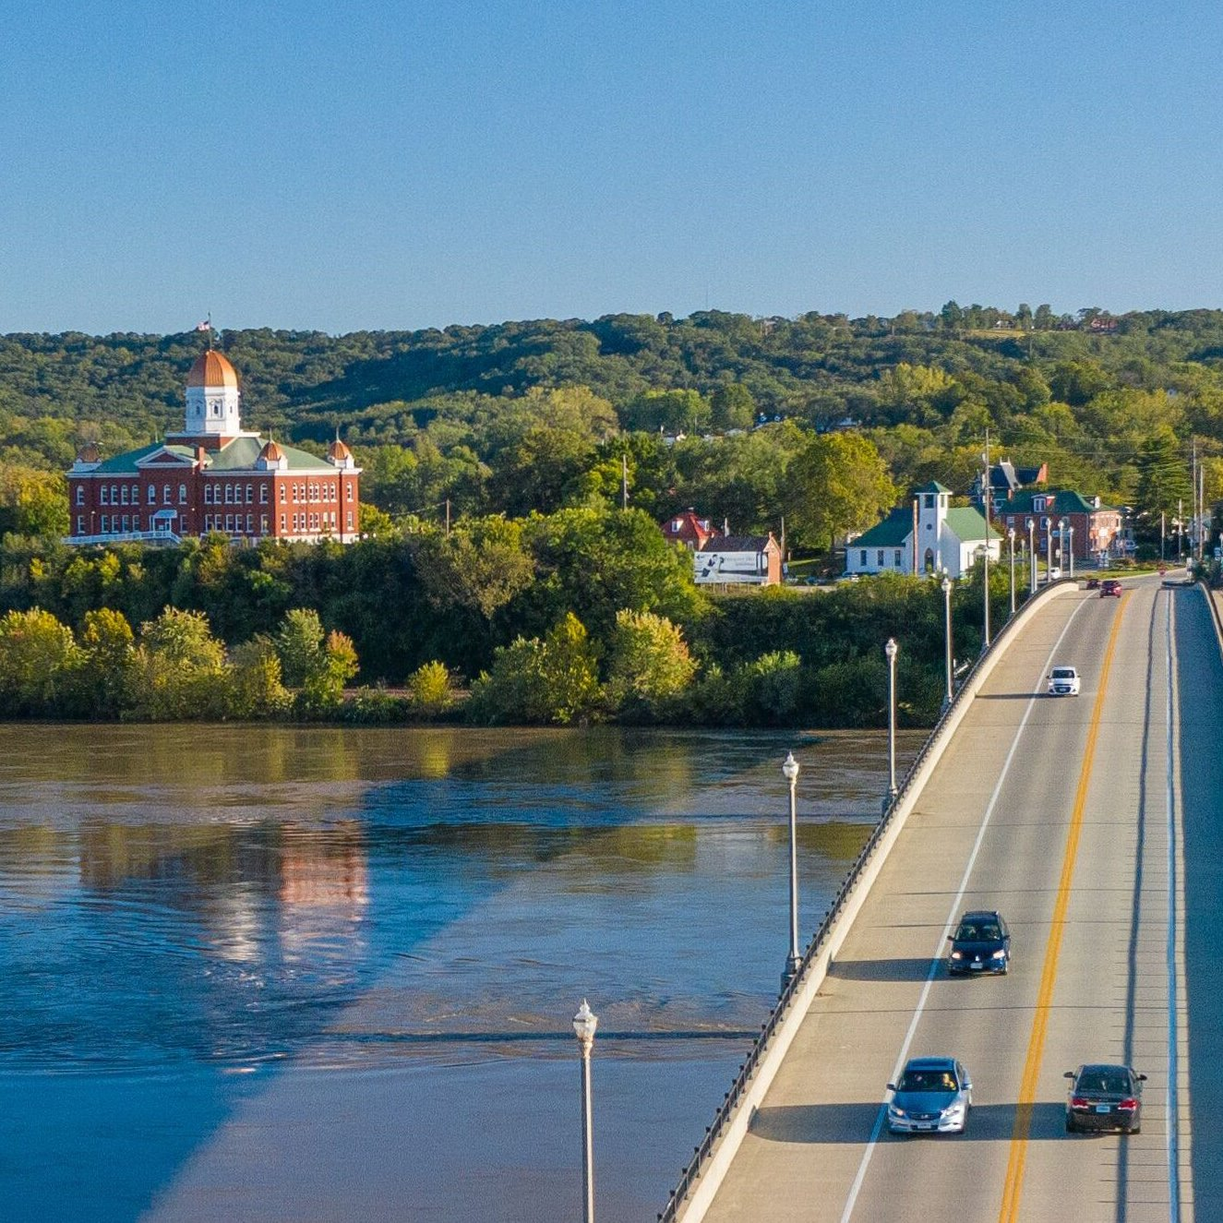
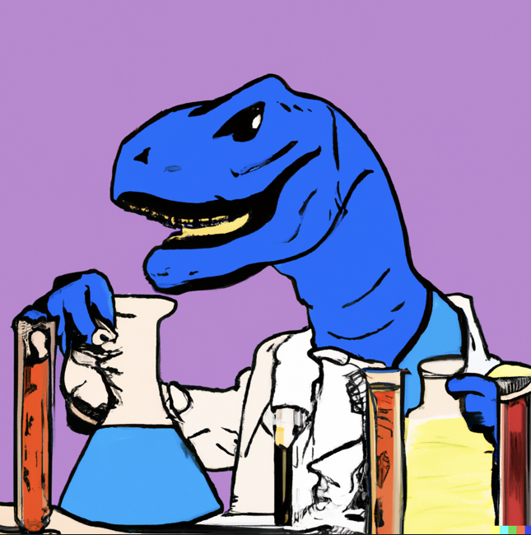
Journey to MU
Hermann, MO
Science and Computers

Slide 3
Undergrad at MU
Chose biochemistry to major in
Had a hard time deciding if I should double-major
Did CS and IT minors (learned C, Java, HTML/CSS/JS)
Got involved in clubs (ACM and game making, Biochemistry Club, etc.)
Random opportunity to build a “production” application

Slide 4
Changing Directions
Revelation after taking MCAT and doing secondary applications
Got involved in undergraduate research with Dr. Lesa Beamer
  Investigating strained loop conformations
  No wet-lab

Slide 5
Undergrad at MU
1. The amount we don’t know is extraordinary
2. Computational Biology is going to be immensely impactful
3. I wanted to go to grad school
Scientific
community
PhD
lay

Slide 6
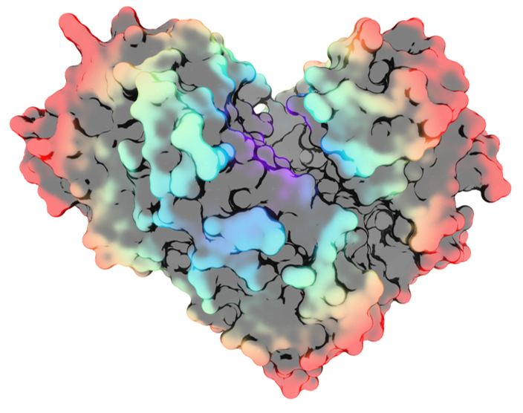
Graduate School at MU
Entered early into graduate school so I did 4 rotations
  Dr. Lesa Beamer – Structural Biology
  Dr. Xiao Heng – Structural Biology
  Dr. Scott Peck – Plant Proteomics
  Dr. Dong Xu – Computational Biology

Slide 7
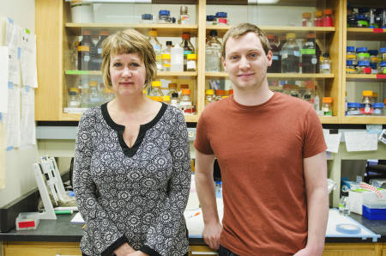
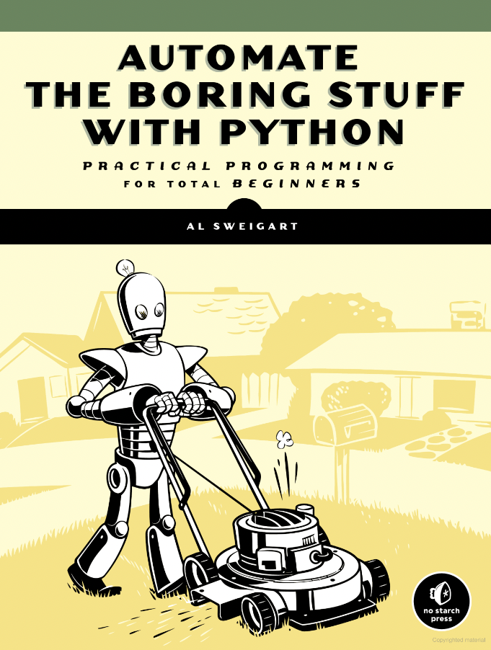
Graduate School at MU
  Really dug into my research and R, Python, and statistics
  I wanted to write my own analyses, make my own plots, and I wanted to automate the boring stuff
  I wanted flexibility in career opportunities
rosalind.info

Slide 8
(Un)sanctioned Programming Projects in Grad School

Slide 9
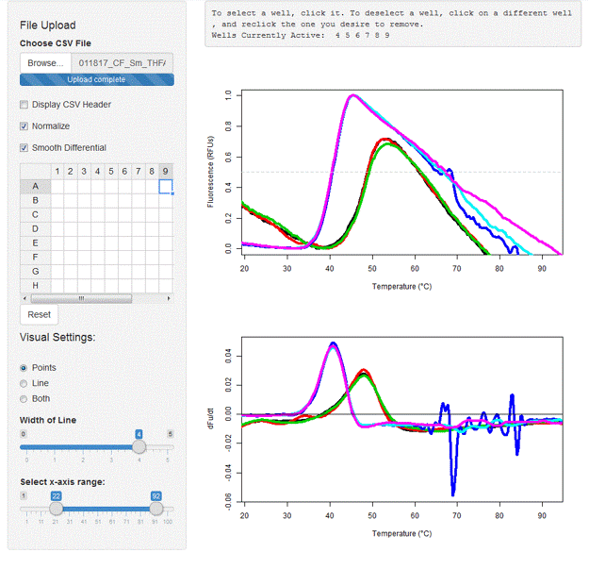
Thermal Shift Analysis Software
Expensive, bad license
Knew I would be doing this assay a lot and probably not only for myself
Chance to ‘automate the boring stuff’ and develop skills
Publish
https://kylestiers.shinyapps.io/TSA_Analysis/

Slide 10
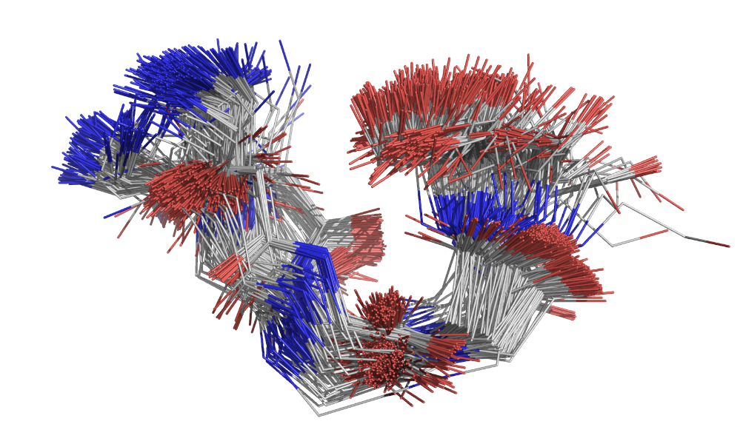
MMTF Fragment Search
Invited to MMTF Hackathon at UCSD
Learned about new MMTF file format
Made a small group for the hackathon and finally got to implement my long-idealized fragment searching algorithm against the whole PDB
Went back again for the meeting in Python
github.com/KyleStiers/mmtf-fragment-search

Slide 11
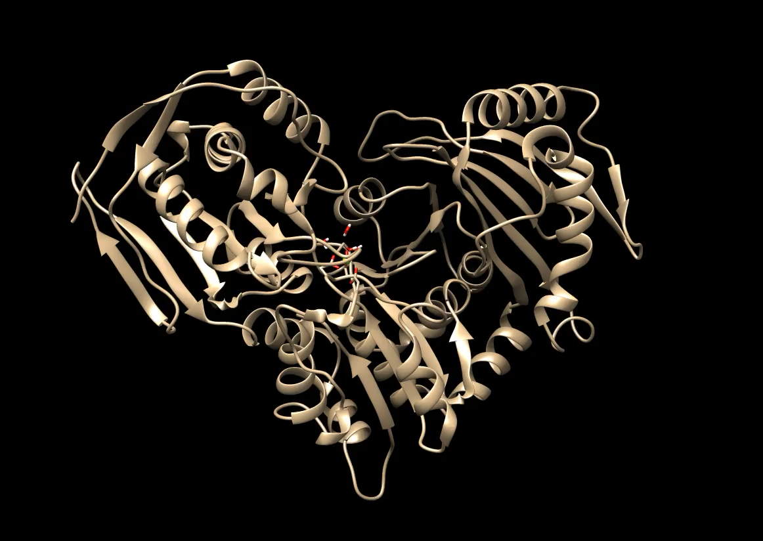
Semi-automating GROMACS MD
Started to do a lot of molecular dynamics
Lots of sketchy, unreliable, hard to use websites exist to ‘automate’
Decided to write some Bash tools to automate running straightforward MD simulations with very minimal changes required from user
Had a few users
github.com/KyleStiers/Science_scripts

Slide 12
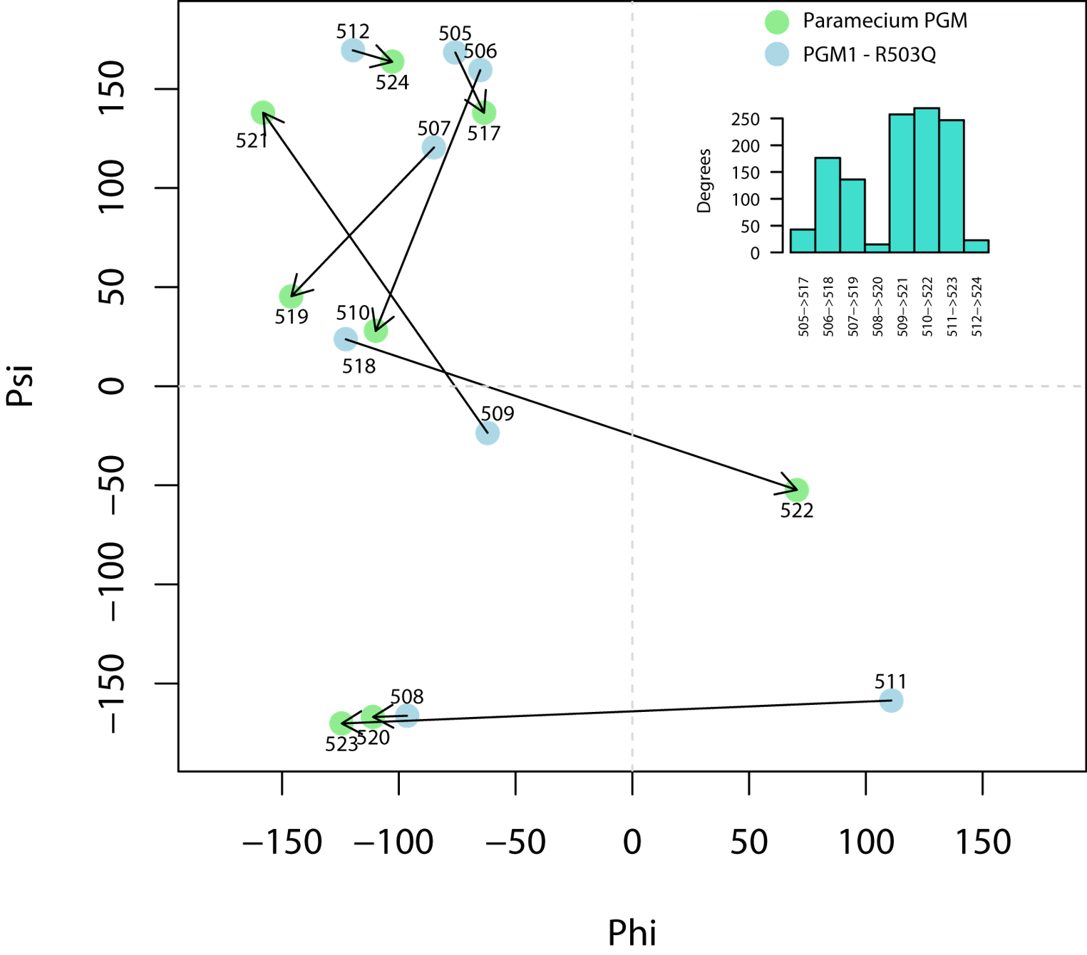
Many, many small projects…
dRama (difference Ramachandran plot)
Ultralite beam (stacked consensus sequence plotting)
ChromapR
Automating docking of N small molecules against a pdb structure
Automating building SAXS model and refinement
Automated PCA of various types of datasets
Super saturation curve plotting tools
Making gifs from crystallography data collection

Slide 13
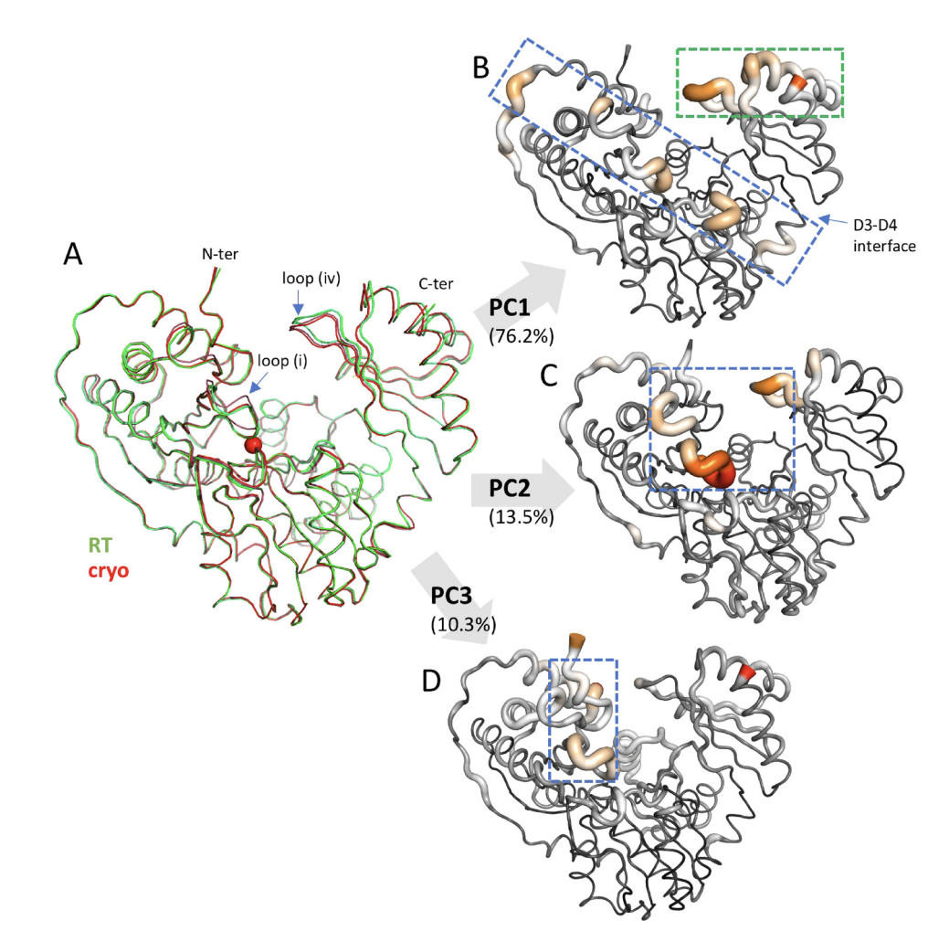
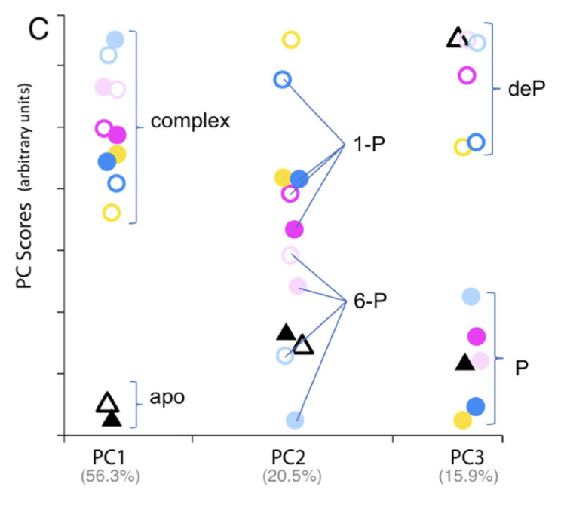
The intersection of computation and biology
Spent years trying to get data for this very specific analysis of dynamic information from crystal structure
Didn’t work as intended so had to find a way to make the data we worked so hard to get useful
Used principal component analysis to
uncover correlated changes in a
collection of protein structures
Got to publish actual code!

Slide 14
Transitioning to Computational Biology in the BAC
  Essentially completely changed fields to genomics
    Required a lot of self-study and learning
  Engineering pipelines for bioinformatic processes
  A very interesting hybrid of academia and industry

Slide 15
Bayer
  Leveraged my background in biochemistry and engineering experience to obtain a Data Scientist position
  ~1 year being on the Trait Biology and Analytics team in the Data Science and Analytics organization
  Working well in teams is expected and critical to success
  Your title isn’t all you’ll do and that’s great for development

Slide 16
Recommendations for during graduate school
  Make a GitHub account and learn to use it!
  Explore opportunities that allow you to develop yourself while also providing a unique benefit to your research
  Make sure to discuss these and any other career interests with PI early and often
  Present at every meeting you can (poster or talk)
  Apply to training opportunities outside your comfort zone

Slide 17
Recommendations for after graduate school
  Stay connected with people from your cohort (LinkedIn)
  Explore postdocs that expand your toolkit
  Apply to everything that sounds interesting

Slide 18
A
GitHub, Python, Linux/Bash, macOS, Docker
B
Nextflow, R, samtools, vcftools, MySQL
C
AWS, GCP, WDL, Nim, Rust
D
Shiny, Snakemake
F
Windows

Slide 19
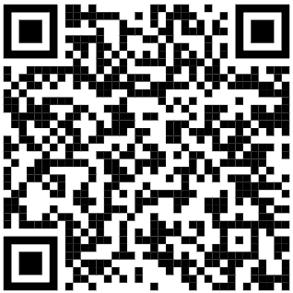
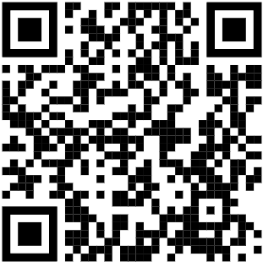
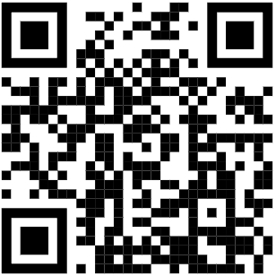
Thanks and feel free to reach out!
Google Scholar
LinkedIn
GitHub

